Slide 1
Tensor based Visual Analytics for Multidimensional Time-series Data
Naohisa Sakamoto Graduate School of System Informatics, Kobe University, Japan
Data Science, Statistics & Visualization 2022 (DSSV 2022) National Cheng Kung University, Tainan, Taiwan June 28, 2022
Notes:
Today I‘m going to talk about Tensor based Visual Analytics for Multidimensional Time-series data

Slide 2
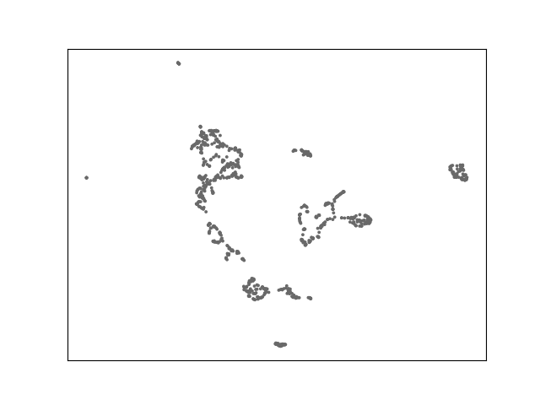
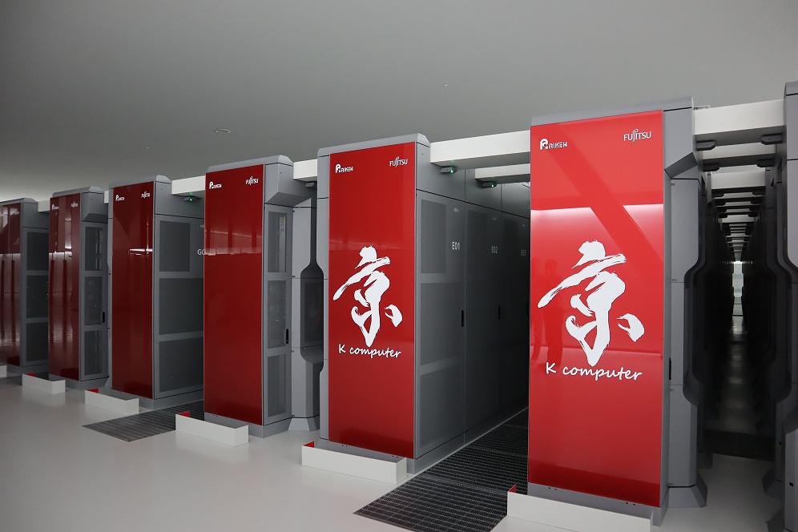
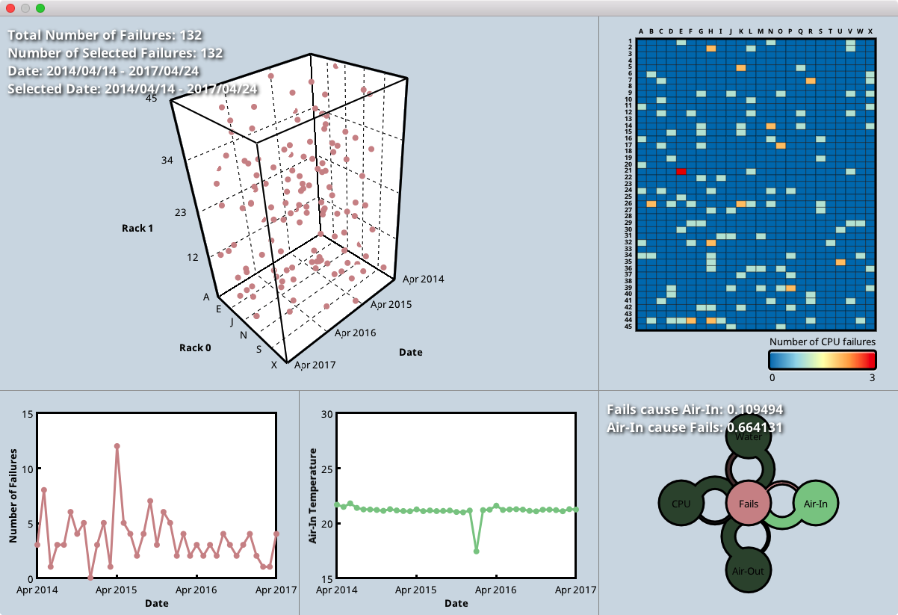
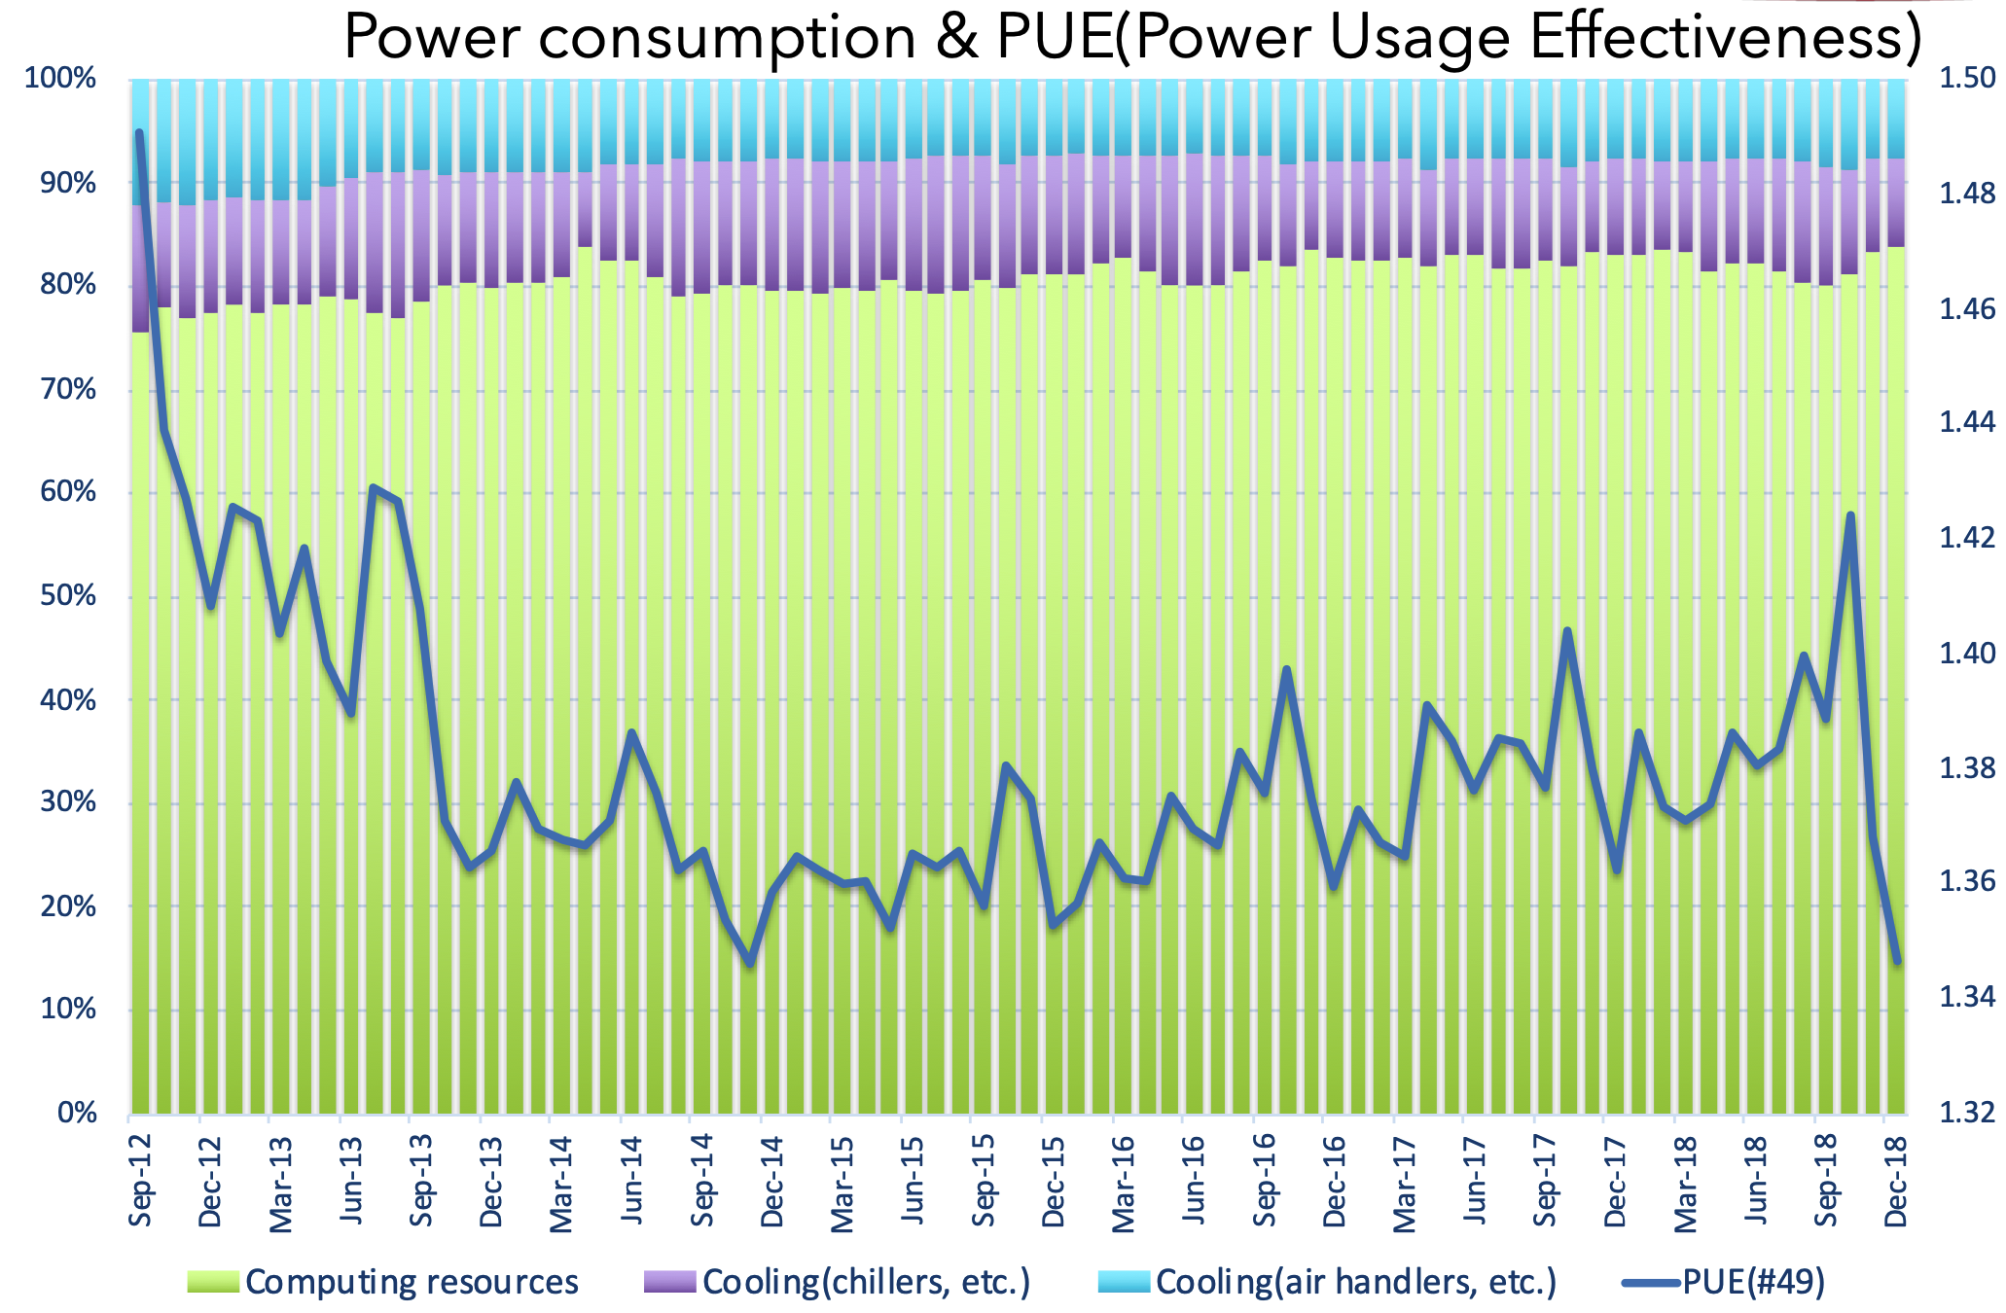
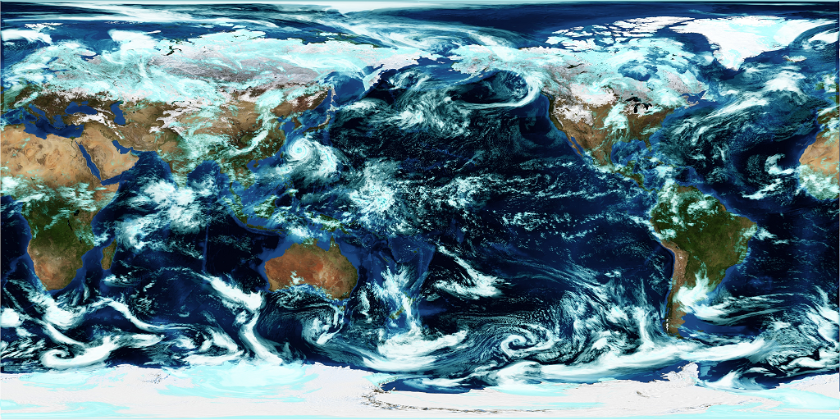
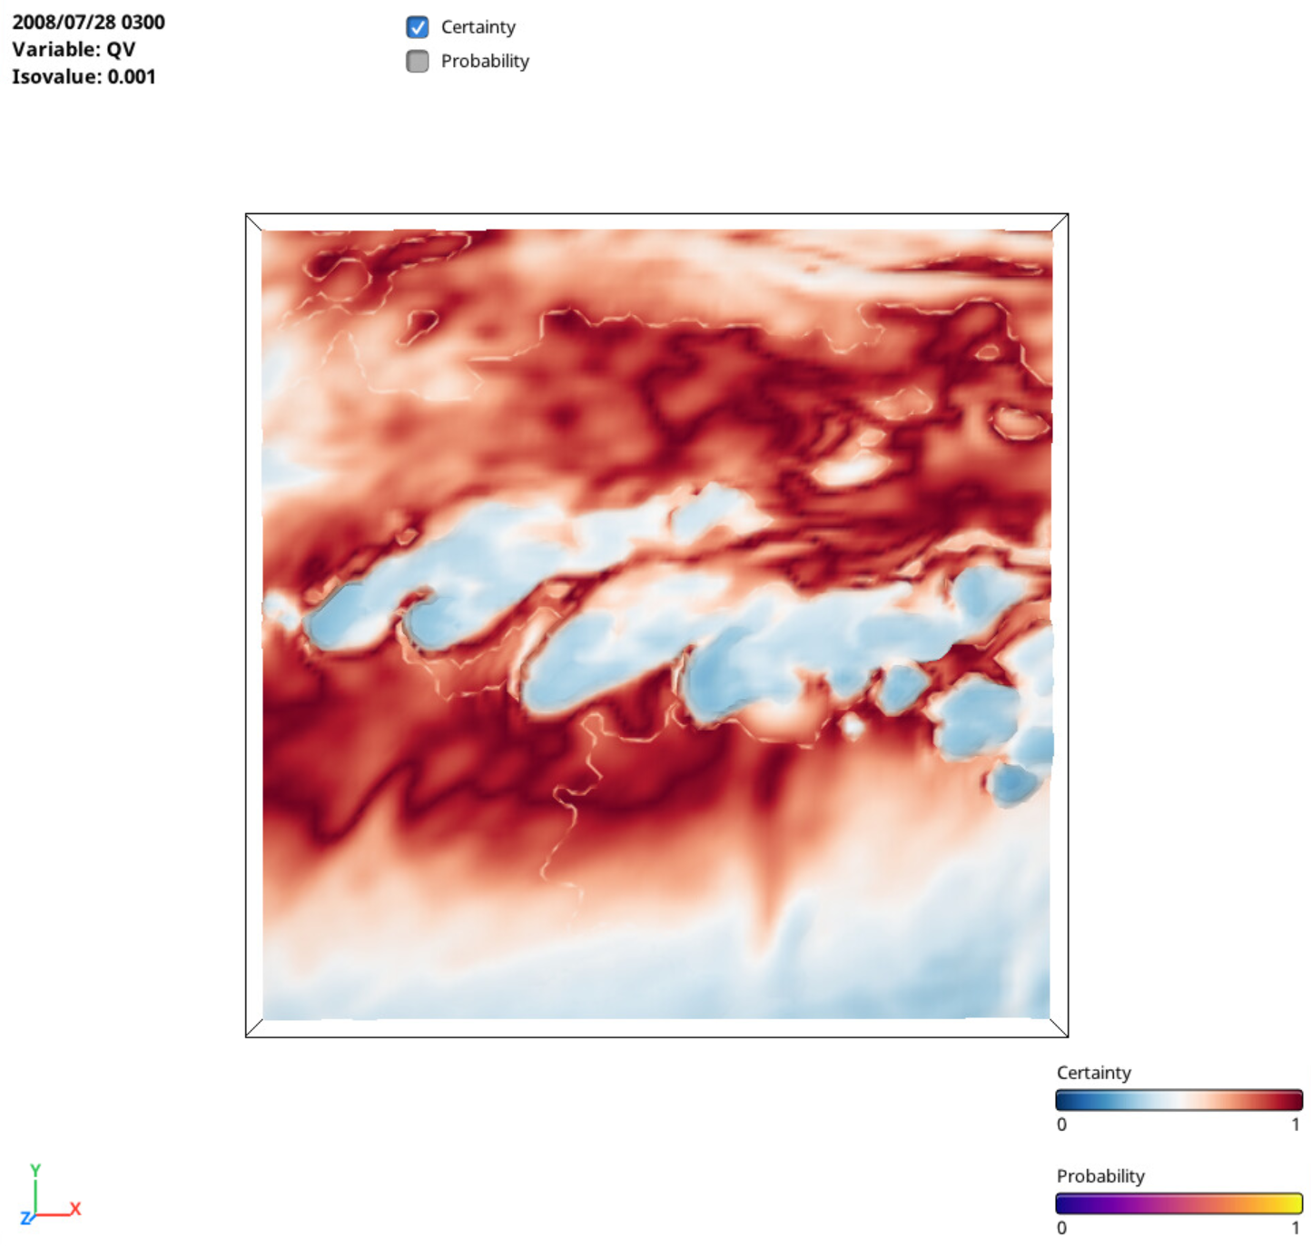
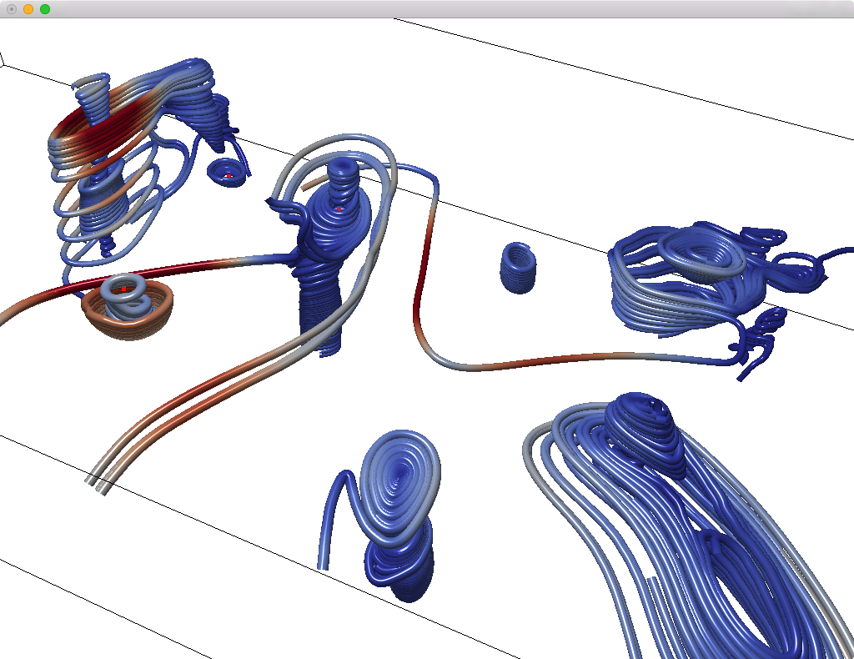
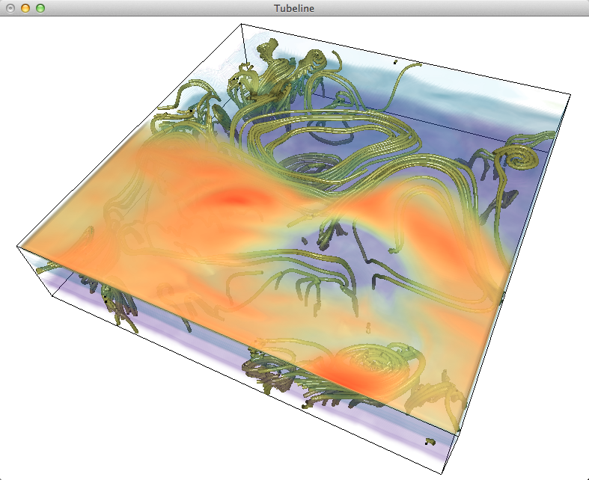
Background
Multidimensional Time Series Data
Table data
Analysis
Measurement data
Volume data
Analysis
Simulation data
Notes:
Our research group is now working on several visualization issues in collaboration with researchers at RIKEN in Kobe.
In this collaboration, we are currently working on several projects with a particular focus on multidimensional time series data.
Analysis of multidimensional time series data is one of the most important and attracting topics in the study of various phenomena occurring in the real world.
(CLICK)
For example, in systems such as supercomputers, various values are measured using sensors, and these dataset are stored in a database as time series log data.
(CLICK)
In addition, as you known, supercomputers are used to run numerical simulations of various phenomena and output a large amount of resulting data.
(CLICK)
These data are analyzed using various visualization techniques.
私の研究グループでは、神戸にある理化学研究所の研究者と協力をして、いくつかの可視化技術に関係する課題に取り組んでいます。 そして、現在、特に多次元時系列データに注目したいくつかのプロジェクトを進めています。
多次元時系列データの解析は、実世界で起こる様々な現象を研究する上で重要なテーマの一つである。
例えば、スパコンなどのシステムでは、センサーをつかってさまざまな数値が計測されており、それらのデータは時系列ログデータとして、データベースに蓄積されています。
また、スパコンを使ってさまざまな現象を対象にした数値シミュレーションが実行され、大量の結果データが出力されます。
これらのデータに対してさまざまな可視化技術を使って解析しています。

Slide 3
Background
Multidimensional Time Series Data
Tensor
data
Analysis
Notes:
In our group, we are currently investigating the use of the tensor data models to provide a unified representation and simplification of these analysis workflows for the multidimensional time-series data.
現在、我々のグループでは、テンソルデータモデルを使って、これらの解析ワークフローの統一的な表現と簡単化を検討しています。

Slide 4
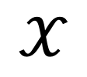
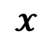
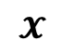
Tensor Data Model
Multidimensional Array
Ex. 3rd order tensor (3 dimensional array)
Basic operations
$$𝓧$$
I₃
Slicing
by i
I₁
$$𝓧$$
I₃
Unfolding
along I
I₃
$$𝒳$$
I₁ x I₂
I₂
Decomposition
I₁
+
+
,
CP decomposition
Tucker decomposition
Notes:
The tensor data model is one of the models that represent such multidimensional time-series data, and analysis approaches that utilize this data model have been proposed in various data analysis scenarios
This is an example of third order tensor represented as three dimensional array data. This tensor data is composed of three axes, I1, I2, I3, and the axis of the tensor is also called ’mode’.
(CLICK)
For such kind of tensor data, several basic data operations are defined, like slicing and unfolding/folding.
Slicing is an operation to extract the sectional plane at the point on a mode. In this case, the plane of I1xI3 is sliced by i on the mode of I2.
Unfolding is an operation to reshape tensor to matrix, and it is also called ’matrization’.
This shows the unfolding along the mode I3, the tensor x is reshaped to a matrix of I3 rows and I1xI2 columns. The operations of transformation the matrix to the tensor is called as ‘folding’.
(CLICK)
Although several decomposition or factorization methods for the tensor data have been proposed so far, in this talk, I will focus on these basic operations such slicing and folding/unfoloding for the purpose of the generation of an overview of the data efficiently.
(CLICK)
テンソルデータ向けの分解技術がいくつか提案されているが、本講演では、データ外観を可視化すること目的として、これらの基本的なデータ操作に着目する。

Slide 5
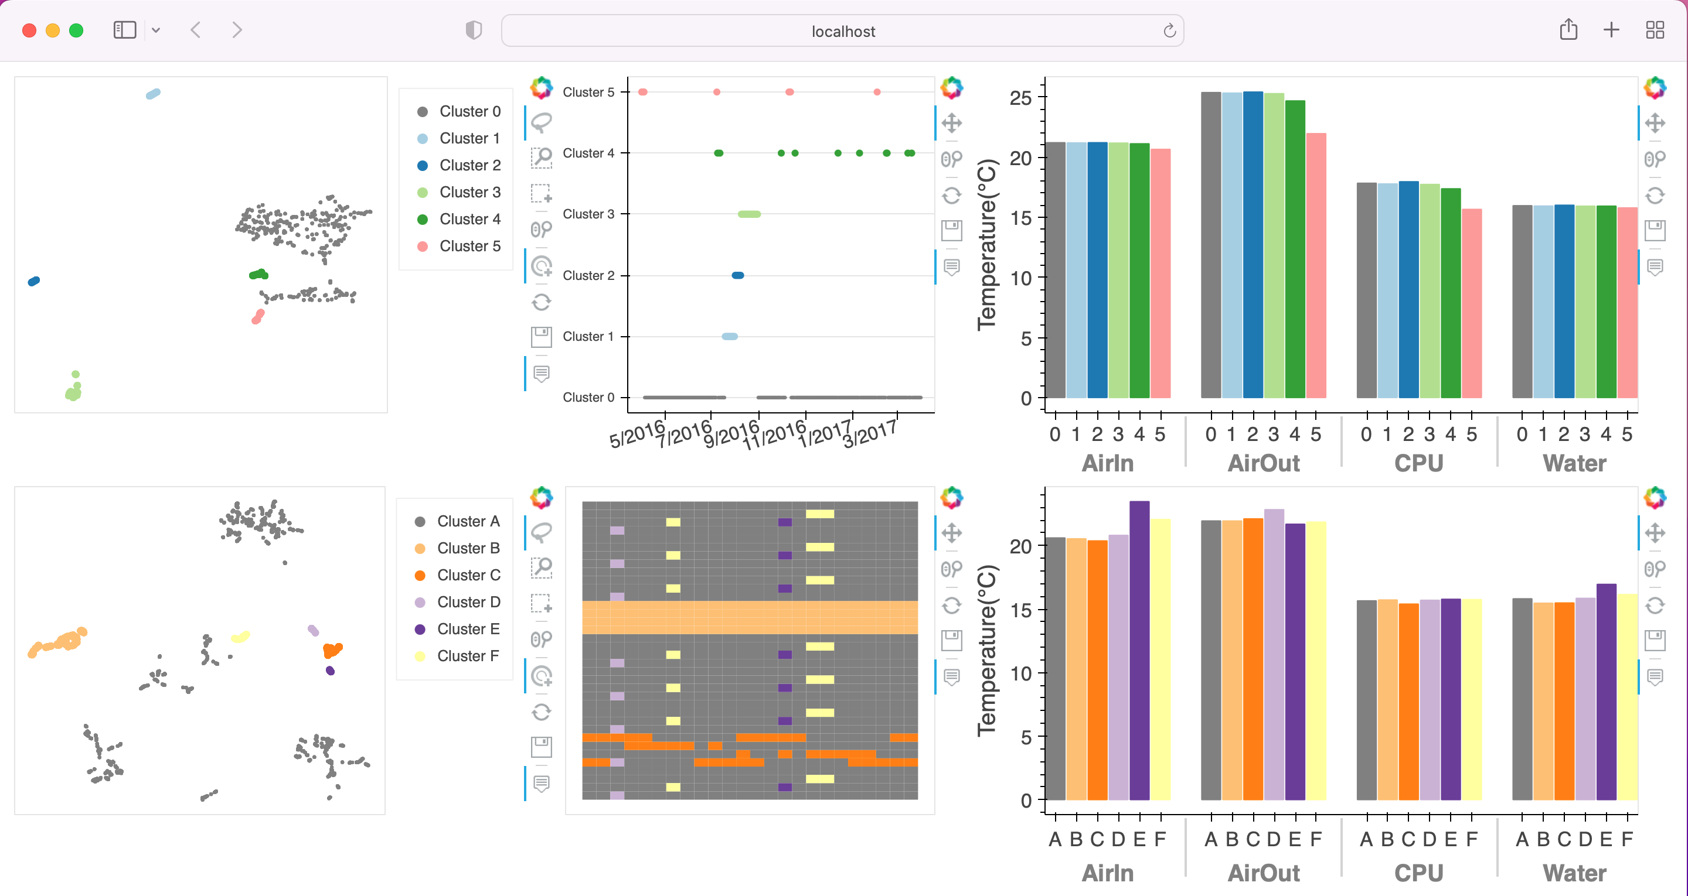
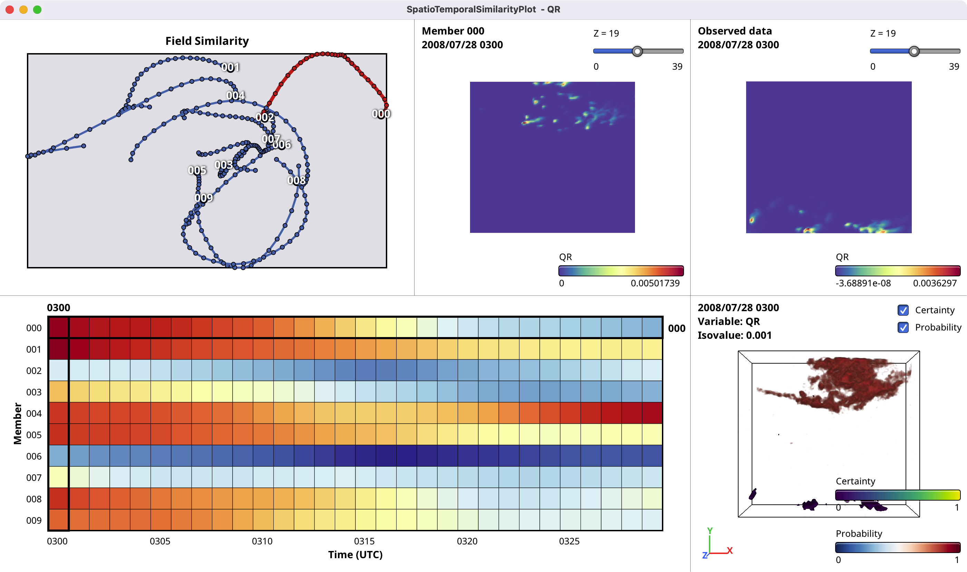
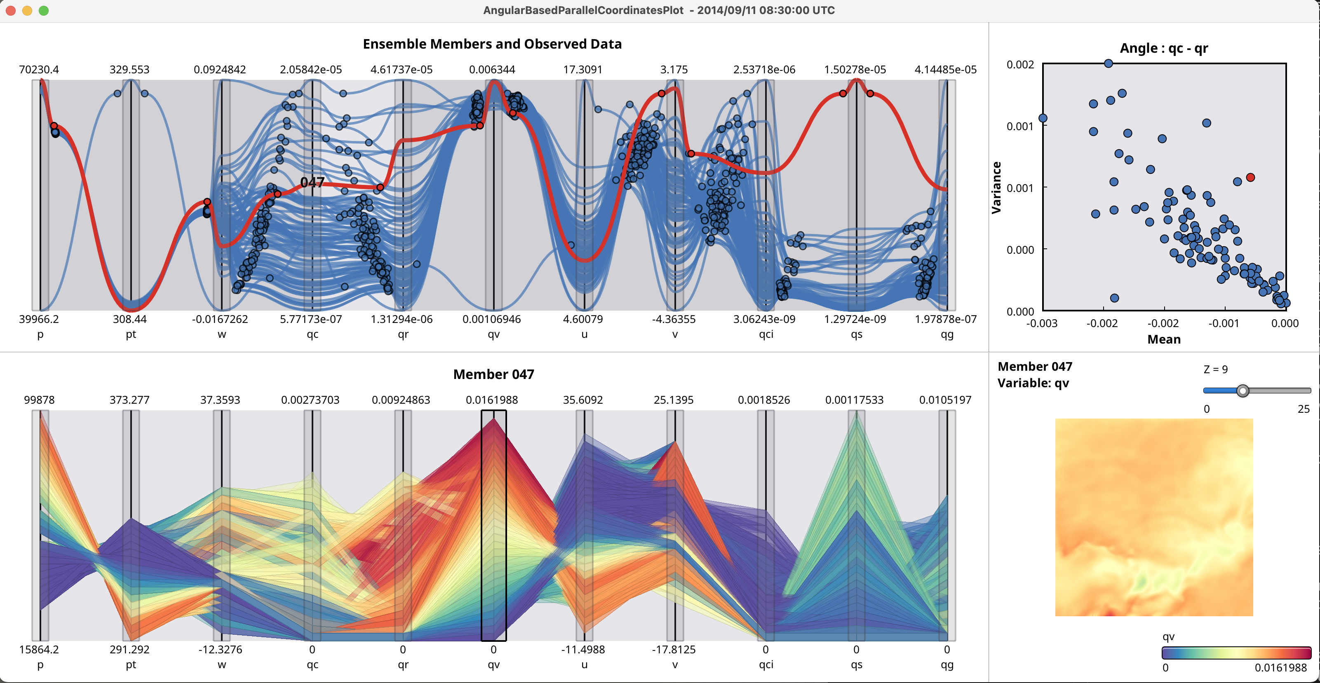
Tensor based Visual Analytics
HPC system log data analysis
Weather ensemble data analysis
HPC log data analysis with multi-step dimensionality reduction
Weather ensemble data analysis based on field similarity
Weather ensemble data analysis with angular based edge bundled PCP
Notes:
In this talk, I will show some examples of visual analytics systems based on the tensor data mode, for analysis of the supercomputer system log data, and weather ensemble dataset.
The analysis of weather ensemble data is an ongoing project, but we would like to present the results we have obtained so far as time permits.

Slide 6
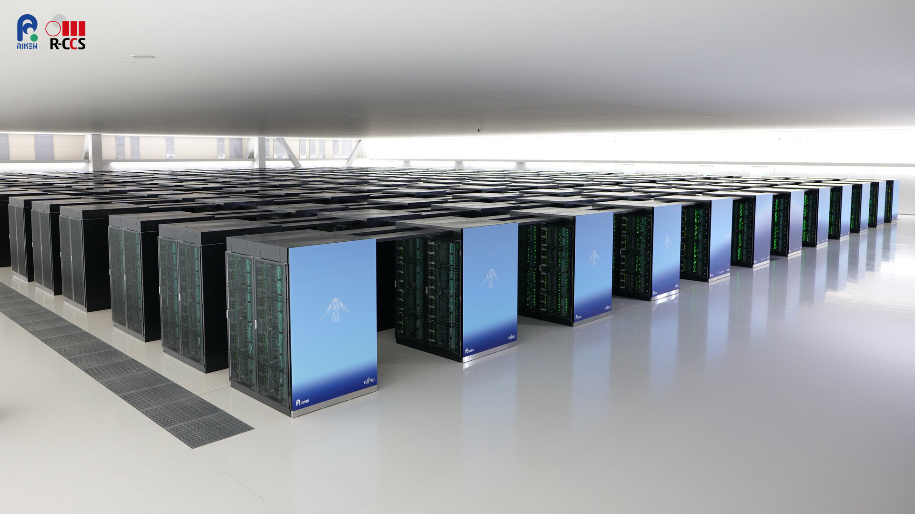
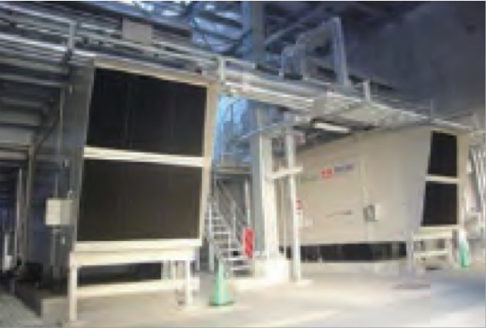
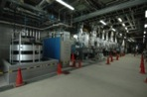
Visual Analytics for HPC System Log Data
Background
Recent advances on high performance computing (HPC) systems
Continuously increasing the size, complexity and performance
Supercomputer Fugaku (ex. 158,976 nodes)
Highly important to ensure a reliable and stable operation
Various environmental data from sensors
For monitoring the hardware system
There is a demand for an effective operational data analysis tool to understand its behavior
K computer (SPARK64)
Sep.2012 to Aug.2019
Fugaku (ARM-based A64FX)
Mar.2020 - present
[F.Shoji, Operation of the K computer and the facility, The 1st R-CCS International Symposium, 2019]
Notes:
First of all, I will introduce a visual analytics of HPC log data.
High performance computing, or HPC, has become indispensable in various fields of science and engineering.
Continuous demands for larger and faster computations have continuously increased the overall size and performance of the HPC systems.
In the modern HPC systems, various environmental data can be collected from a set of sensors, and can be used to monitor the status and behavior of the hardware system.
They are usually stored as log data and can be considered as a kind of Big Data.
There is a growing demand for an effective operational data analysis tools and applications to understand the HPC system behavior.

Slide 7
Environmental Log Data
Log data from sensors (3rd order tensor data)
Variable (T)
Temperature
AirIn, AirOut, CPU, Water
Space (S)
Rack position
# of racks: 864
Time (T)
Measurement time
361 days (April 2026 – March 2017)
V : 4
S : 864
System configuration of the K computer
T : 361
Notes:
Here is an example of the environmental log data represented as third order tensor data.
In our current system, we use the data generated by the K computer.
The log data is composed of three modes, variable, space and time.
The variable V is temperature measurements, AirIn/AirOut are temperatures of the air cooling system. CPU is CPU temperature, and Water is cooling water temperature.
The space S is rack positions consist of 854 racks, and the T is measurement time composed of 361 days.
Here is the shape of this log data represented as a third order tensor.

Slide 8
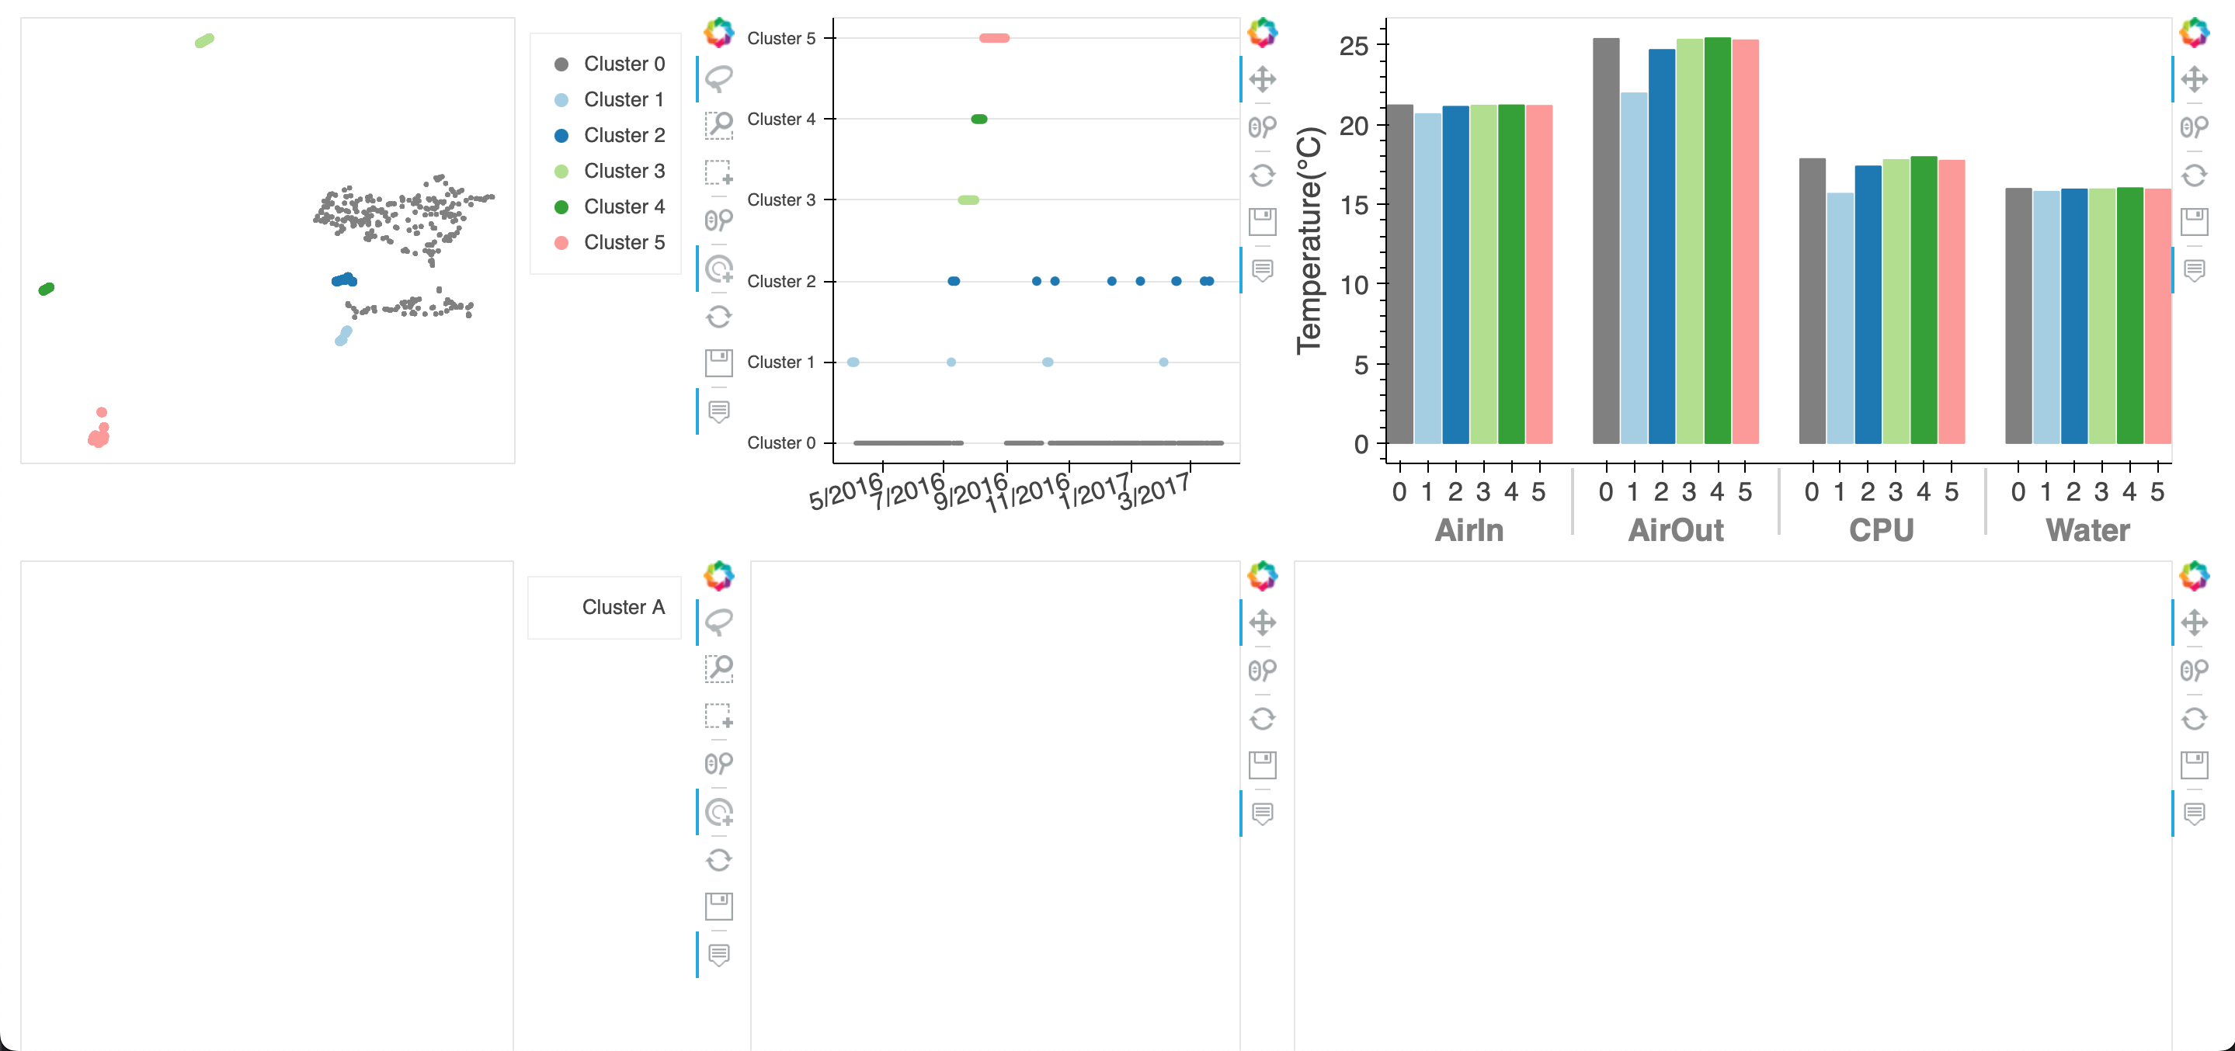
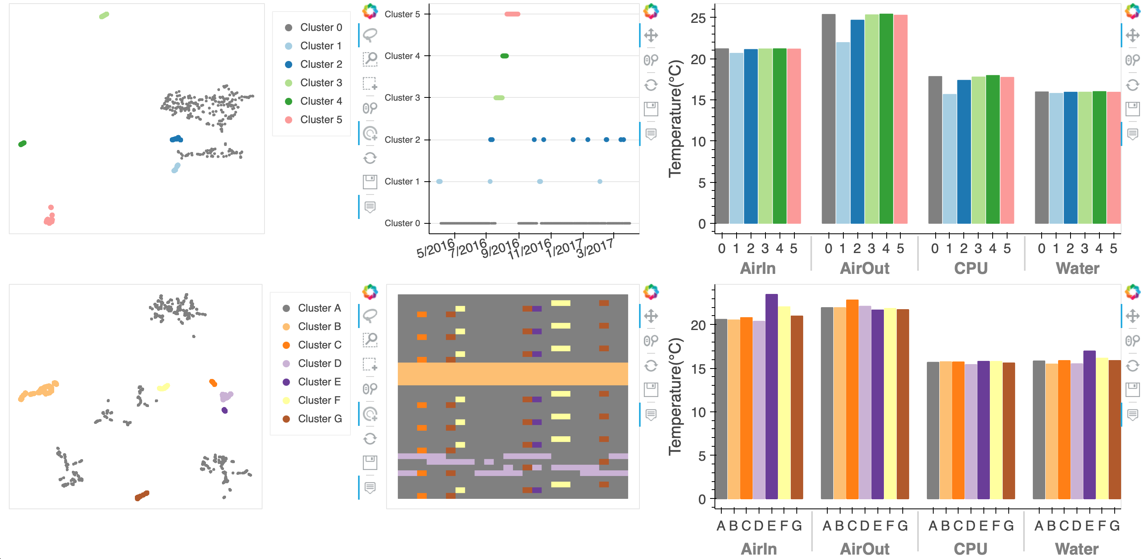

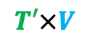
Workflow
$$S×V$$
2
V
Select & compare
clusters
T
Unfolding
along T
Dimensionality Reduction (DR)*
DR plot
S
T
2
V
Folding
S
T’
$$T′×V$$
2
Select & compare
clusters
S
Unfolding
along S
DR*
DR plot
Data
Analysis
Visualization
Interaction
* Inspired by Multi-step DR: T.Fujiwara, Shilpika, N. Sakamoto, J. Nonaka, K. Yamamoto, and K.‑L. Ma, A Visual Analytics Framework for Reviewing Multivariate Time-Series Data with Dimensionality Reduction, TVCG, 2020.
Notes:
This shows overview of our system workflow. The workflow is composed of unfolding and folding and dimensionality reduction technique for the tensor data.
This DR technique is inspired by Muti-step dimensionality reduction technique proposed by Fujiwara.

Slide 9
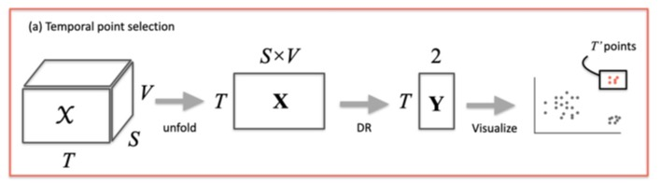
Workflow
Finding temporal point clusters that show characteristic behaviors
Unfold the tensor X into a matrix X with T rows x (SxV) columns
Apply DR to X and obtain a matrix Y with T rows x 2 columns
Plot Y in a 2D space and select the temporal points of interest
Notes:
In the first step, we apply dimensionality reduction to select temporal point clusters that show characteristic behavior of the HPC system.
Since DR can be applied to matrix data, in our system, we convert the third order tensor data to matrix data X by unfolding along T.
And then, apply DR to this X and obtain a matrix Y with T rows x 2 columns.
And plot Y in a 2D space (T mode space) and select the temporal points of interest.

Slide 10
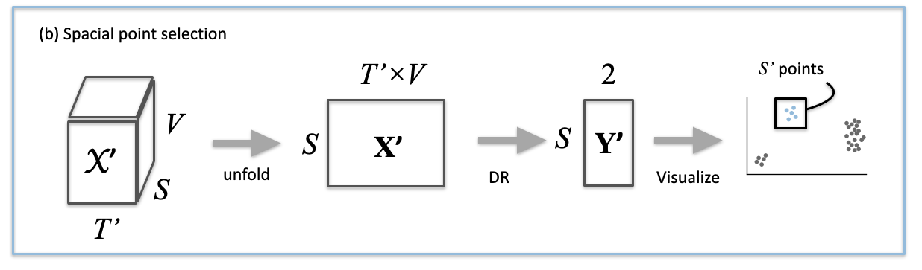
Workflow
Finding space point clusters from the data corresponding to the selected temporal points
Extract X' corresponding to T' points from X
Unfold X' into a matrix X' with S rows x T'xV columns
Apply DR to X' and plot the obtained Y' in a 2D space
Notes:
In the same manner, we can also select the spatial points of interest as shown here.
After the selection of T’ temporal points of interest from all T points, we extract X’, the portion of log data, corresponding to the selected temporal points.
Then, we follow a process similar to the time selection, and select the spatial points of interest S’ plot in a 2D space (S domain space).

Slide 11
Visual Analytic System
HPC log data analysis
Notes:
This is our visual analytics system implements aforementioned workflow.
This grouped bar chart shows averaged temperatures for each cluster and each variable.

Slide 12
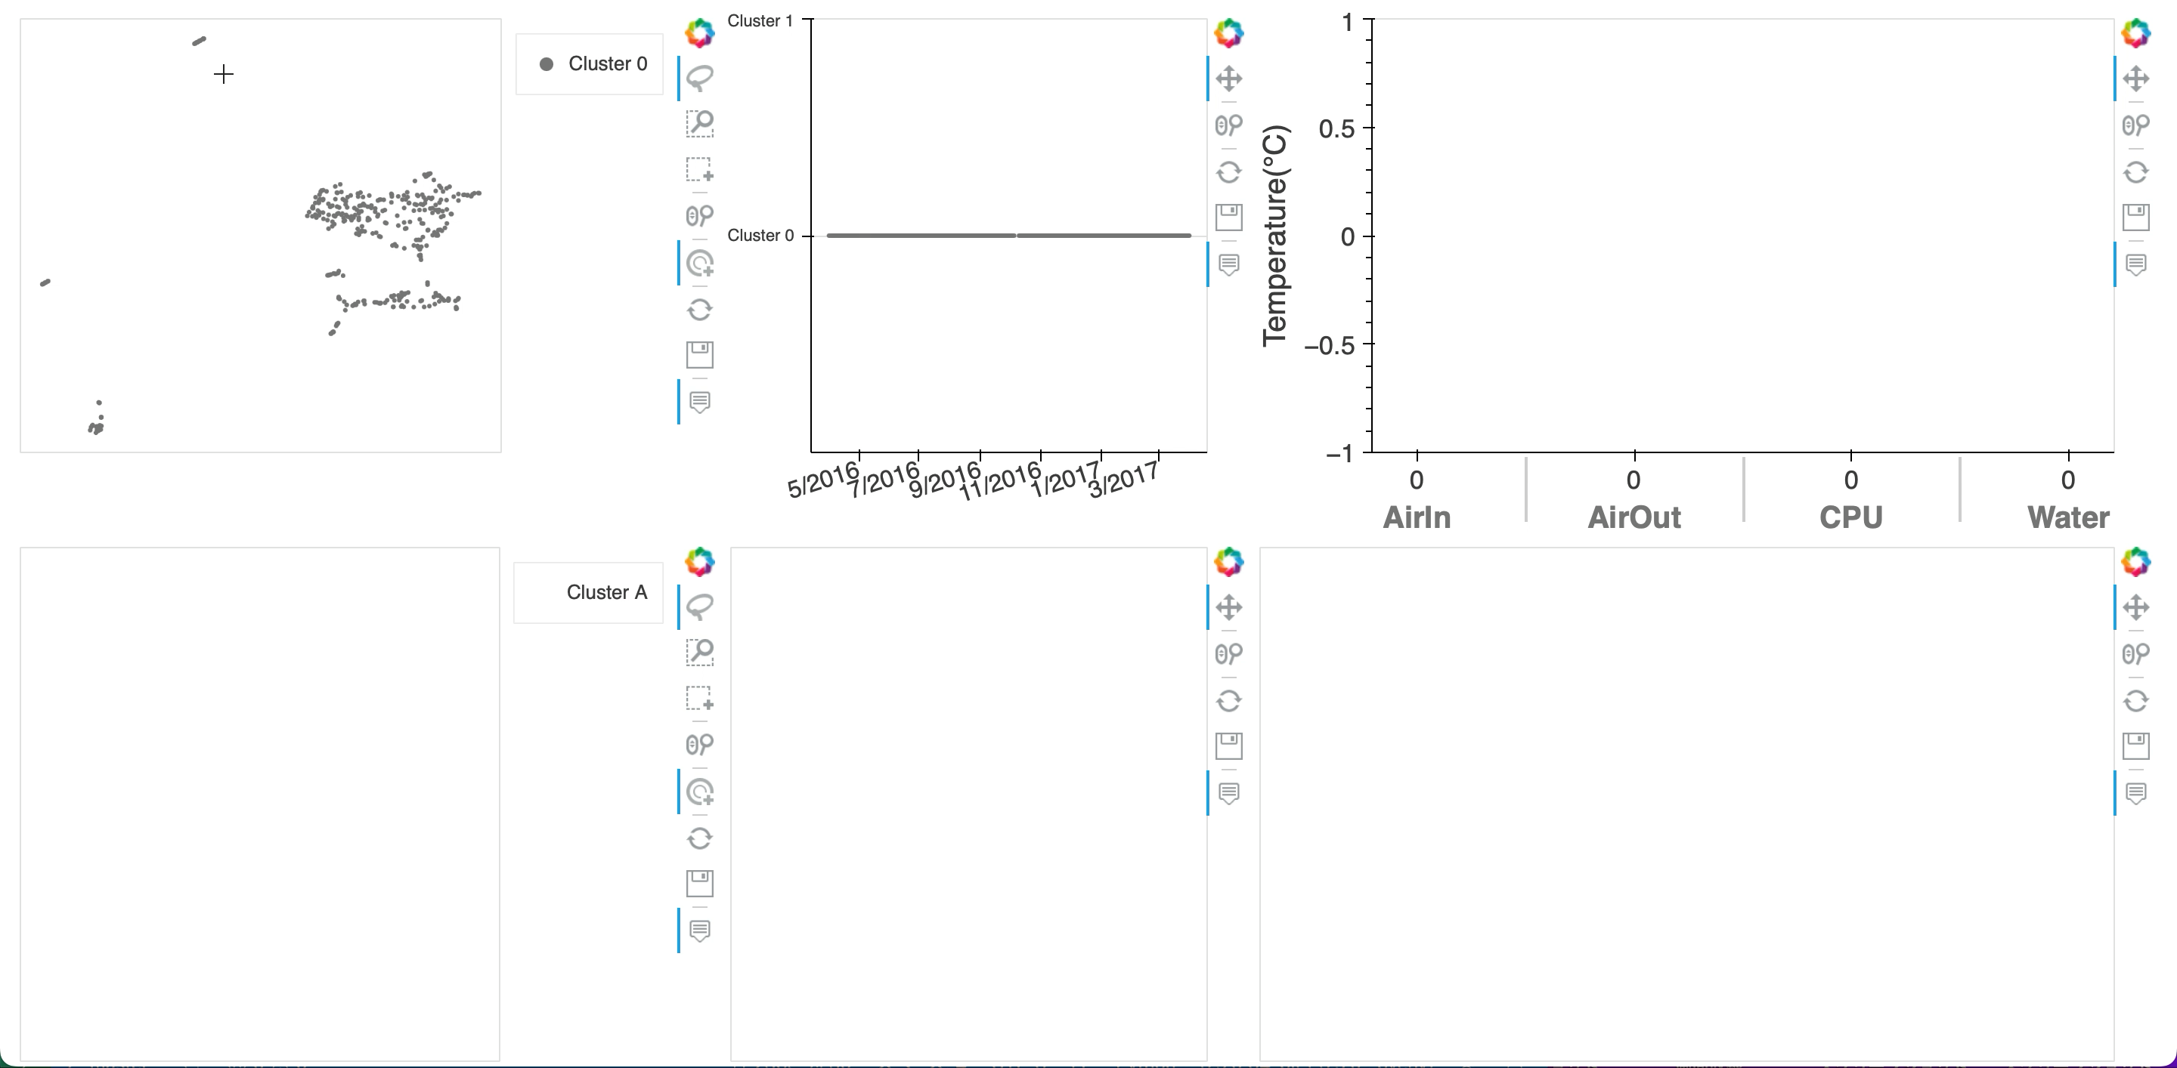
Notes:
This shows demo movie. User can select clusters while checking its plotting results in the T or S mode space, interactively like this.

Slide 13
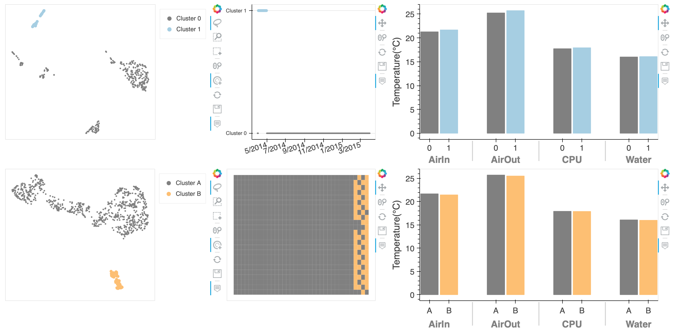
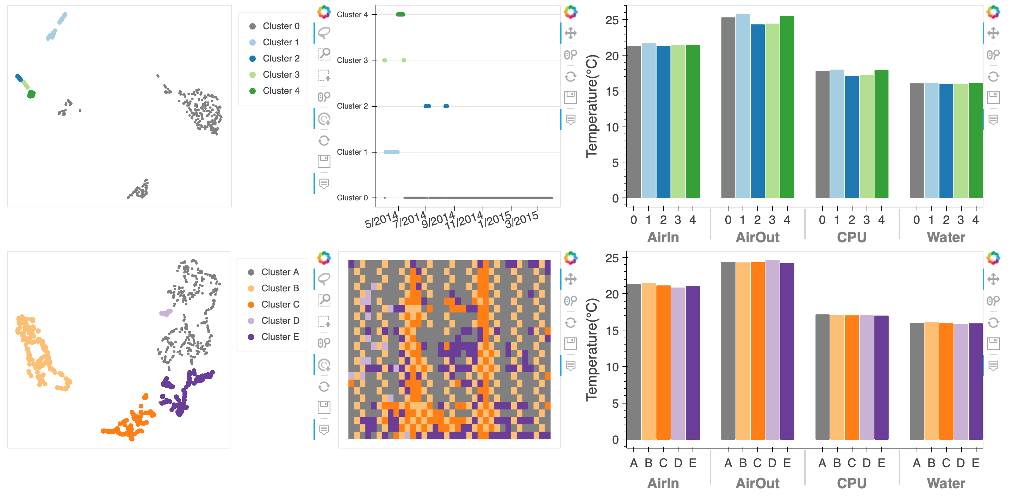
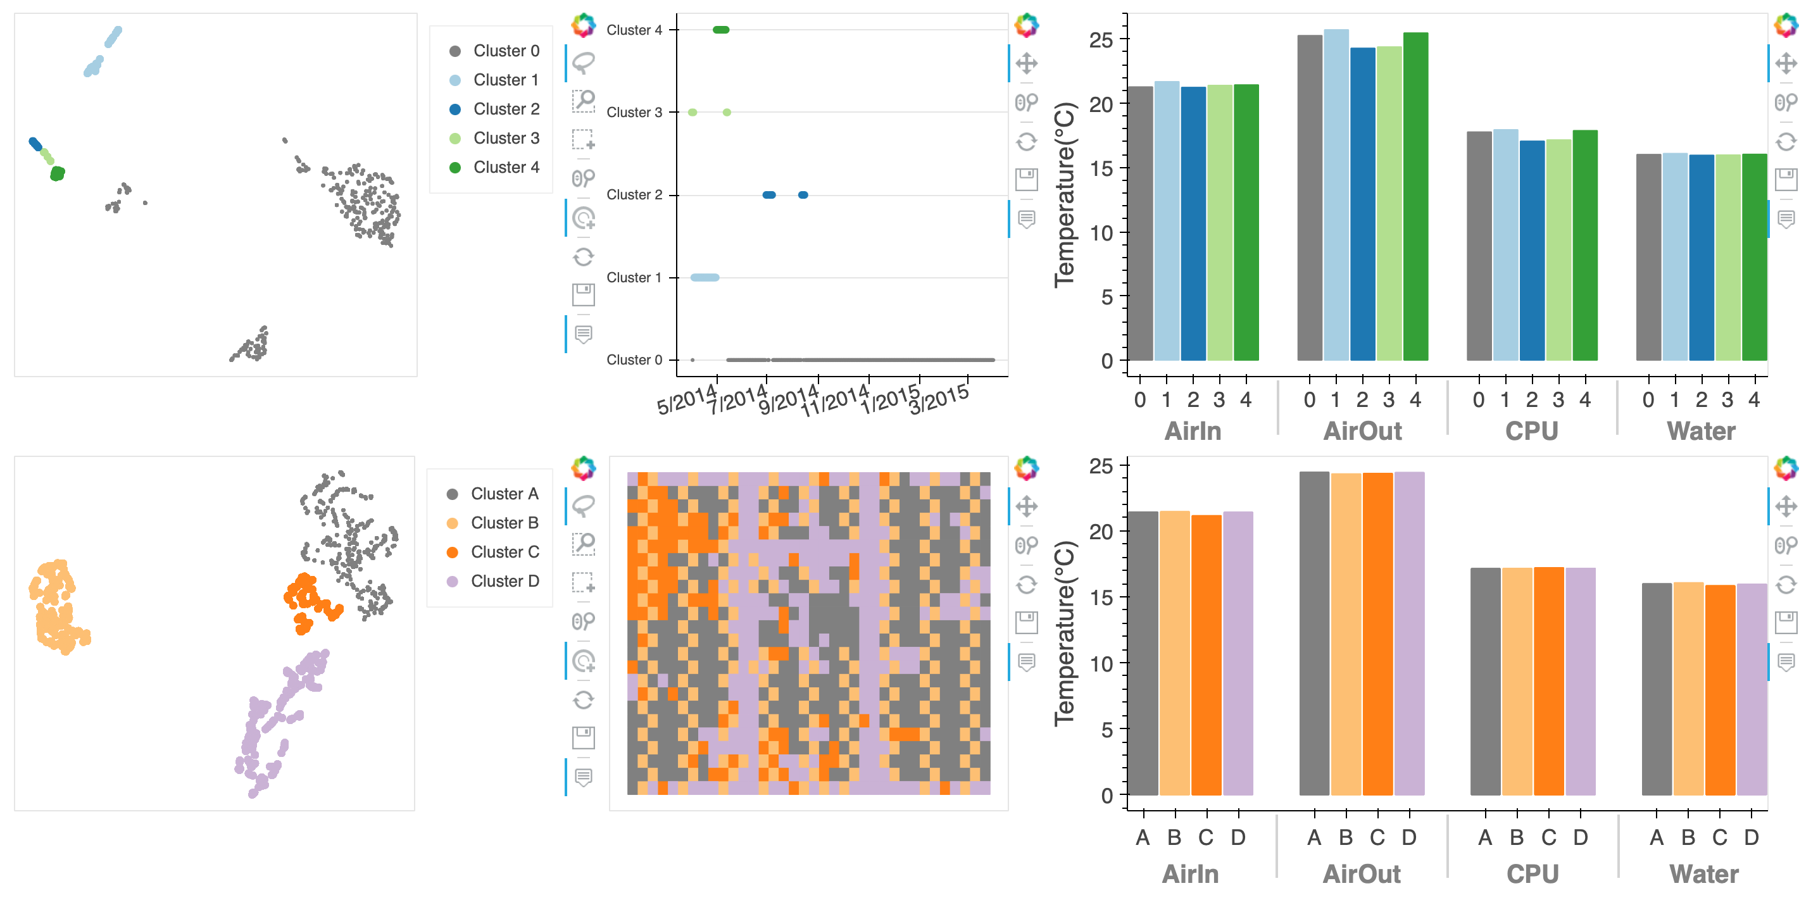
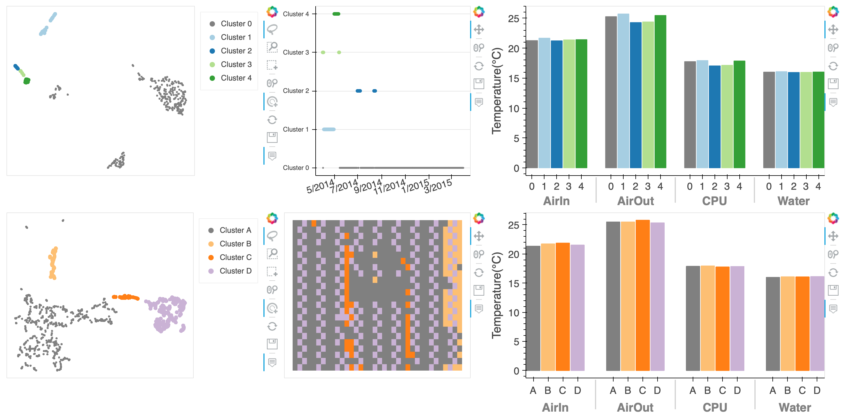
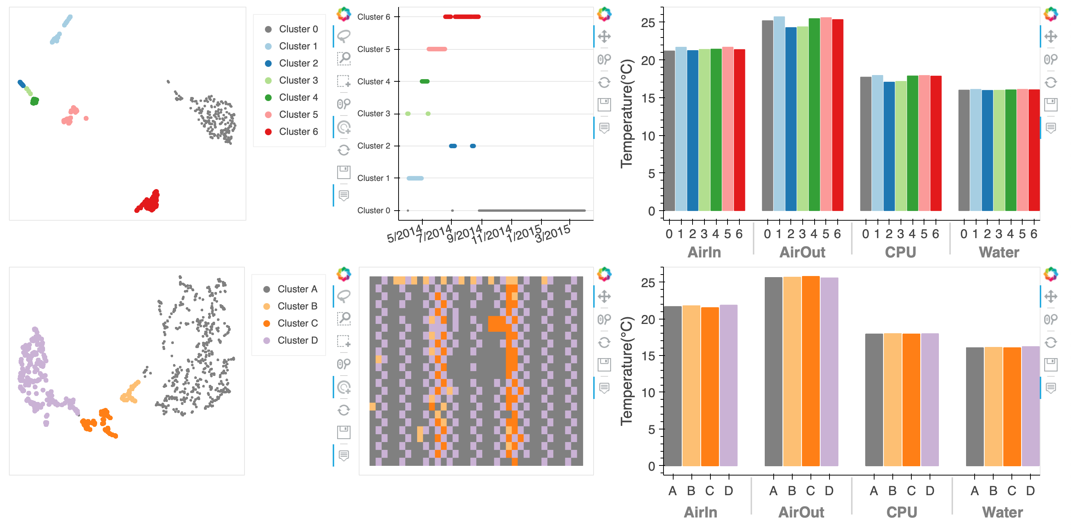
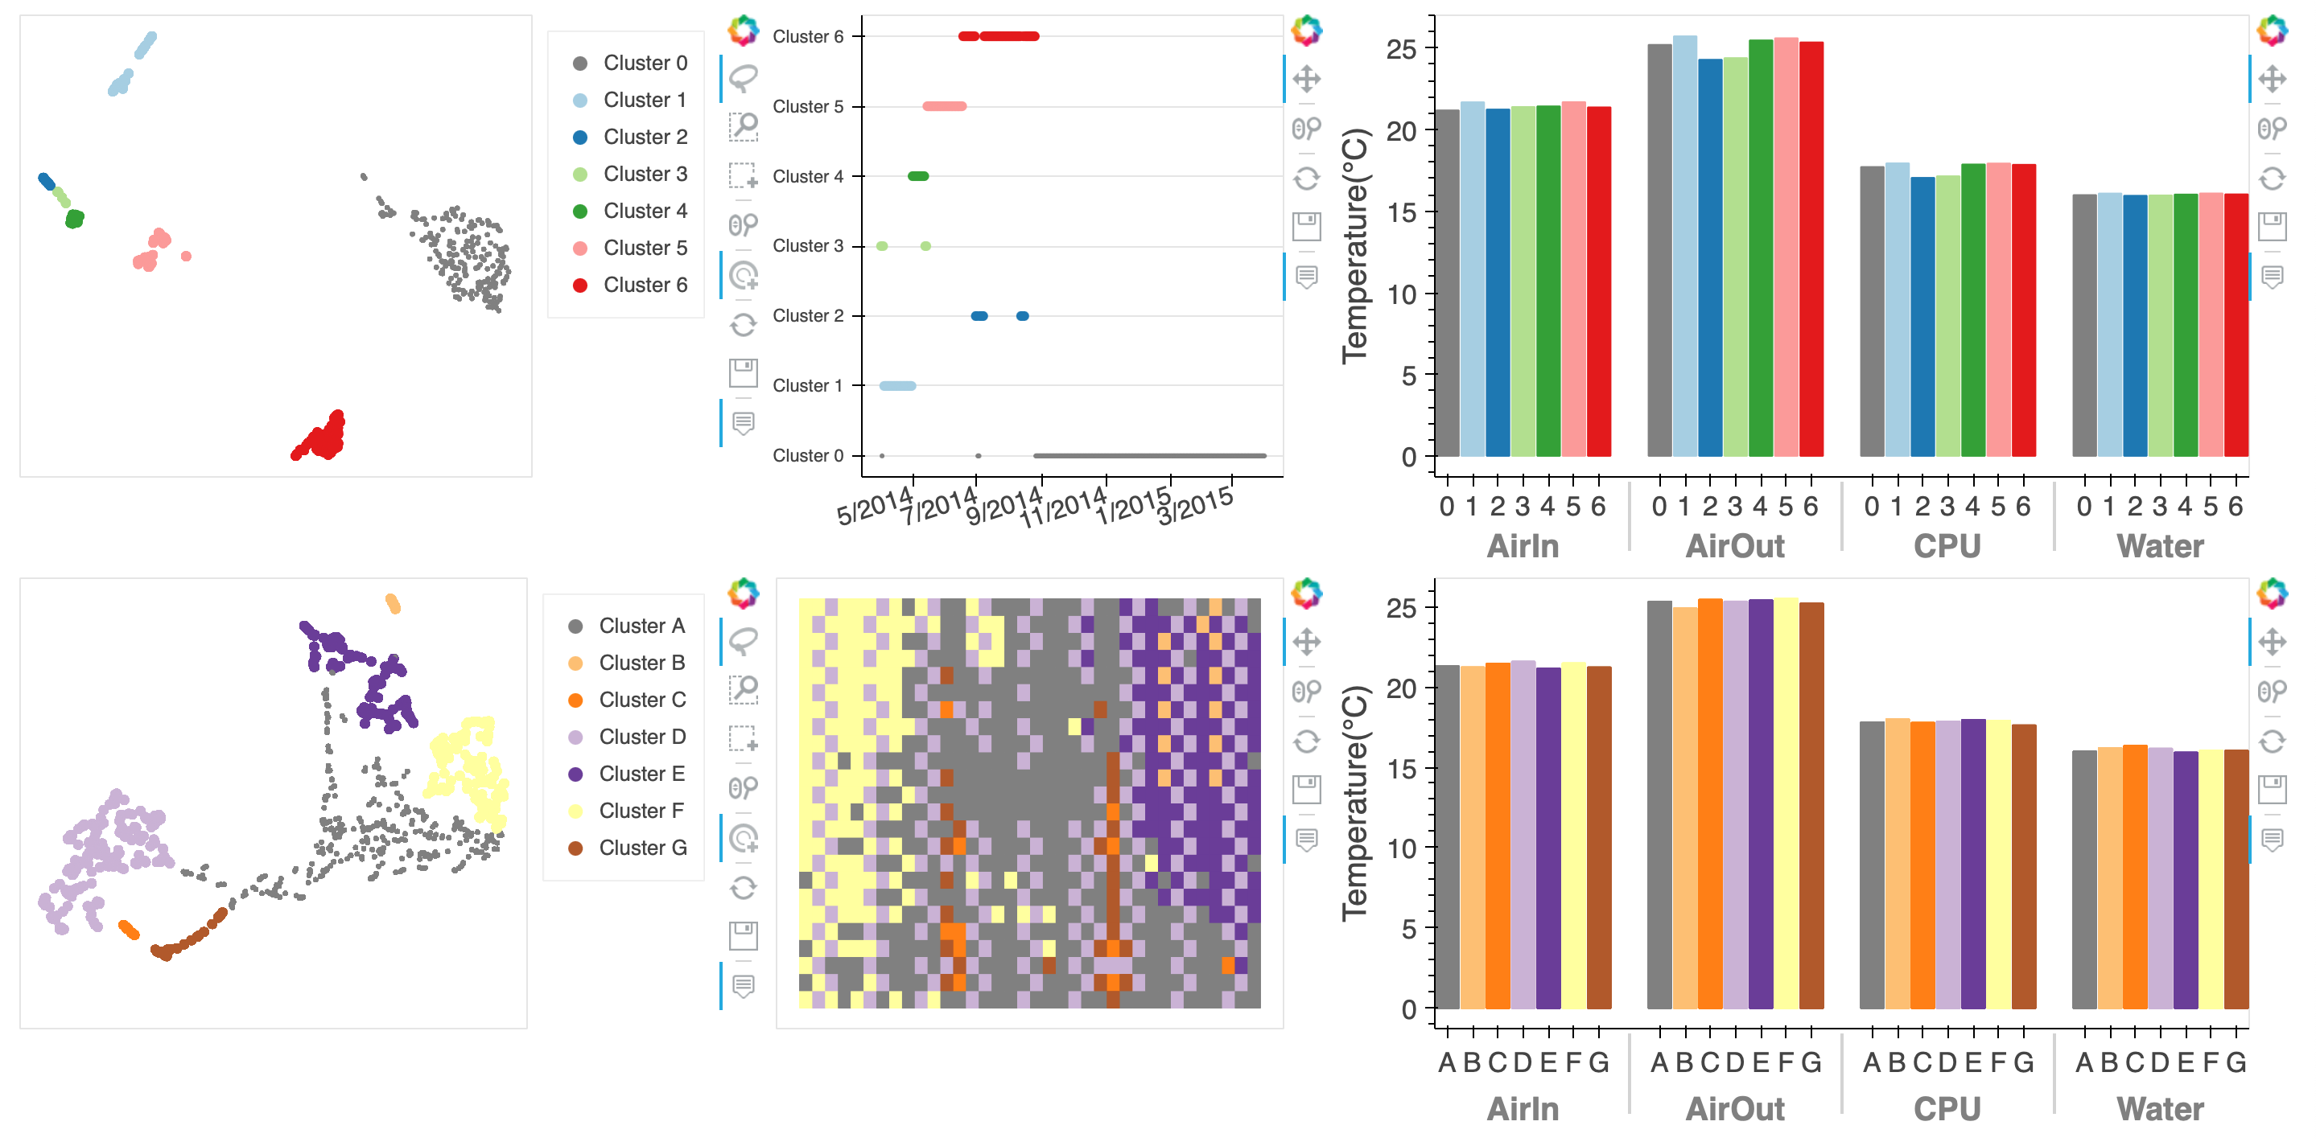
Example of analysis
Temporal & Spatial point selection
Cluster 2
Cluster 3
Cluster 1
Cluster 4
Cluster 5
Cluster 6
→ Effected by the Gordon Bell Challenge
→ No characteristic patterns
Notes:
Here is an example of the temporal and spatial point selection.
The upper scatterplot is the DR result of the log data for the time selection.
Each point represent one day.
The points placed close means the behavior of HPC system on each day are similar.
(CLICK)
The below scatterplot is the result of plotting selected temporal points (cluster 1) with further dimensionality reduction. (CLICK)
If we select the lower-right point cluster shown with orange color in this plot, we can see that these points within the cluster are the racks located at the right region of the spatial domain.
When we confirmed this results with the engineers in the system operational division, they commented that this could be due to the logical connection structure of each rack and the job scheduling system.
(CLICK)
In addition, the cluster 1 just coincided with the Gordon Bell Challenge period, and since we did not see this characteristic rack placement patterns when we selected the other clusters, we believe that the jobs executed during this period resulted in the characteristic job placement.
(CLICK)
These results confirm the effectiveness of our proposed system.

Slide 14
Visual Analytics for Weather Ensemble Data
Background
Guerrilla Rainstorm
Flood accident in Toga river, Kobe, 2008.7.28
Prediction using supercomputers for disaster prevention and mitigation from sudden and unexpected torrential rain
https://www.youtube.com/watch?v=gwrwHNVsFe8
Notes:
The second example is the analysis of weather data.
Japan is a disaster-prone country, and most of the local government offices have been monitoring critical areas such as rivers. The RIKEN research team related to the meteorological science has been conducting research on the prediction using supercomputers for disaster prevention and mitigation from sudden and unexpected torrential rain since the flood accident occurred in Toga river in Kobe 2008.

Slide 15
Visual Analytics for Weather Ensemble Data
Weather ensemble simulation
Reproduce future atmospheric conditions by running multiple weather simulations with different initial conditions
Probabilistic forecasts that account for uncertainties in weather models
…
Condition #1
Condition #2
Condition #3
Condition #n
Parallel world
Statistical analysis
Multiple ensemble members
Multi-variate
Multi-timesteps (time-varying)
Notes:
In this project, we target on the weather ensemble simulation data.
Weather ensemble simulation is a numerical simulation technique which can reproduce future atmospheric conditions by running multiple weather simulations with different initial conditions,
and is used for the probabilistic forecasts that account for uncertainties in weather models.
The HPC-based ensemble simulations, with combined data assimilation, have generated large time-varying, multivariate, and multivalued outputs posing a particular challenge to the visualization and analysis tasks. In such simulation, in addition to the traditional tasks of investigating the spatiotemporal behavior between the ensemble members, it also becomes highly important to understand how the ensemble members evolves over the time in comparison to the ground truth data.

Slide 16
Weather Ensemble Data
4th order tensor data
Member (M), Field (F), Variable (V), Time (T)
M
m₁
V = {v₁, v₂, …}
F
・・・
m₁
V
T
T
F
t₁
t₂
t₃
3rd order tensor
m₂
V = {v₁, v₂, …}
・・・
F
・・・
V
m₂
T
T
4th order tensor
F
t₁
t₂
t₃
3rd order tensor
Notes:
The data generated from the ensemble simulations can be assumed as 4th order tensor data.
(CLICK)
The weather ensemble data is represented as a set of ensemble members M.
(CLICK)
Each ensemble member has field, times and variables defined on each grid point, and can be assumed as 3rd order tensor data.
(CLICK)
Therefore, the weather ensemble data is a set of 3rd order tensor data, that is, 4th order tensor data.

Slide 17
Visual Analytic System
Weather ensemble data analysis
DR plot view
Cross-sectional
plot view
Probabilistic
isosurface
plot view
Timeline heatmap plot view
Notes:
This is the overview of our visual analytics tool for interactive exploration of ensemble members and ground truth data.
This system is composed of (CLICK) dimensionality reduction plot view to show the spatio-temporal behavior of the ensemble members and ground truth data, (CLICK) timeline heatmap view to show the similarity between members and ground truth along the time domain axis, (CLICK) cross-sectional plot view to show and compare the spatial distributions of the variable for the selected member and the ground truth, (CLICK) probabilistic isosurface plot view to show the uncertainty distributions of ensemble members.

Slide 18
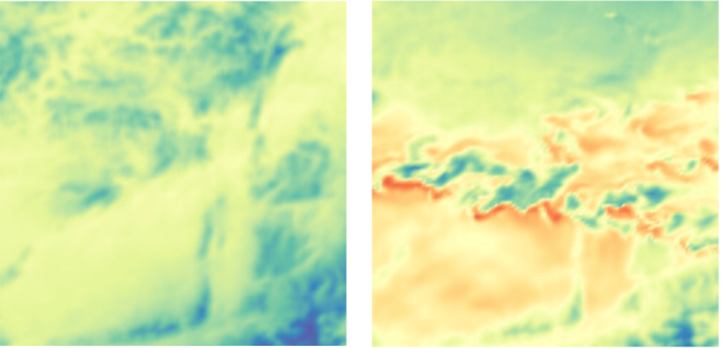
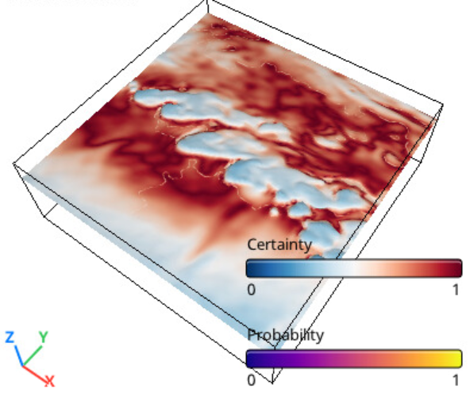
Workflow
Analysis with the fixed variable point (v_{i})
M
V
M
Compare members
F
Slicing
by v_{i}
Slicing
by t_{j}
Cross- Sectional Plot
T
F
T
V
Probability
Find spatial region
of interest
Unfolding
by F
Probabilistic Isosurface Plot
F
2
T
Observe members behaviors in spatio- temporal space
…
DR
DR Plot
V
Similarity
Find times and members of interest
F
Timeline Heatmap Plot
T
Data
Analysis
Visualization
Interaction
Notes:
This is the overview of the system workflow. The workflow is composed of slicing, unfolding and dimensionality reduction.
In this system, first, we generate the 3rd order tensor by slicing with the specified vi from the input 4th order tensor.

Slide 19
Workflow
Analysis with the fixed variable point (v_{i})
Unfolding
along F
Notes:
First, the 3rd order tensor obtained by slicing with vi is unfolded along F, and converted to the matrix X.
This matrix X consists of time-varying volume data arranged by ensemble member.

Slide 20
Workflow
Analysis with the fixed variable point (v_{i})
Similarity*
* Similarity: A.Fofonov et.al.. Projected field similarity for comparative visualization of multi-run multi-field time-varying spatial data. CGF, 2019
Notes:
Then, dimensionality reduction is applied to the matrix X to generate the matrix X’ which is a set of 2D vector F‘, by using MDS.
In our current system, we use projected field similarity to evaluate the distance between members.

Slide 21
Workflow
Analysis with the fixed variable point (v_{i})
Notes:
And then, the dimensioality reduced data X’ is visualized every member as a connected scatterplot, like this.

Slide 22
Workflow
Analysis with the fixed variable point (v_{i})
Notes:
To facilitate quantitative analysis along the time domain, the matrix X’ is also visualized in the form timeline heatmap. The colors of the heatmap mean the similarity between the member and the ground truth data.

Slide 23
Workflow
Analysis with the fixed variable point (v_{i})
K. Po ̈thkow, etl.al.. Probabilistic marching cubes. CGF, 2011.
Notes:
The time of interest can be specified from the result of the timeline heatmap. By using the time t, the data is sliced.
As shown in this figure, members are sequentially sliced along the field and member axes, and the isosurfaces extracted from each of the members are used to calculate the statistical distribution by using the probabilistic marching cubes.

Slide 24
Workflow
Analysis with the fixed variable point (v_{i})
Notes:
In addition, the certainty of the ensemble members is evaluated based on the distance between the isosurface extracted from the ground truth data and the averaged isosurface.
And then the colors based on the certainty are mapped to the averaged isosurface.

Slide 25
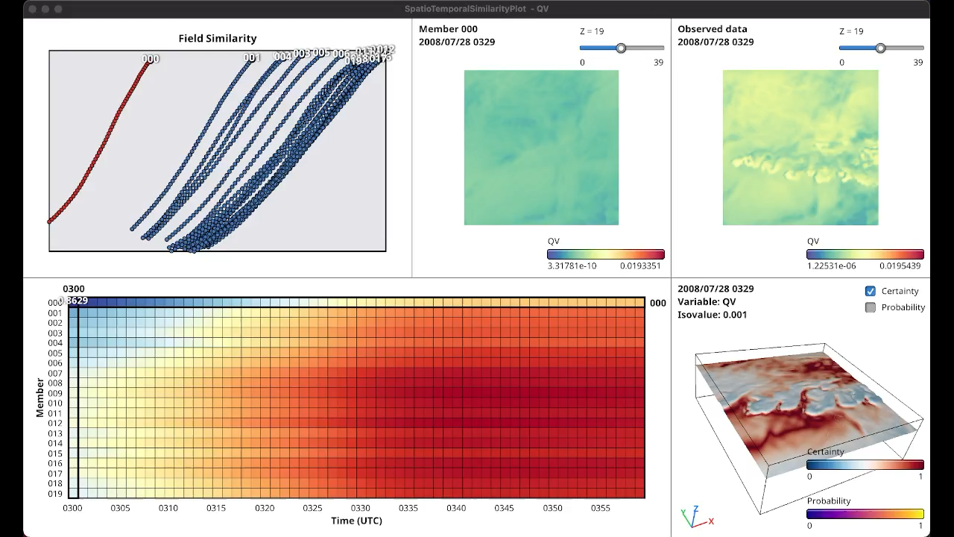
Notes:
This is a demo movie of our proposed analytics system. User can select the time of interest while checking the DR plot view and the timeline heatmap view, and observed the spatial distributions of the variable and the certainty of the members in the cross-sectional view and probabilistic isosurface view, interactively.

Slide 26
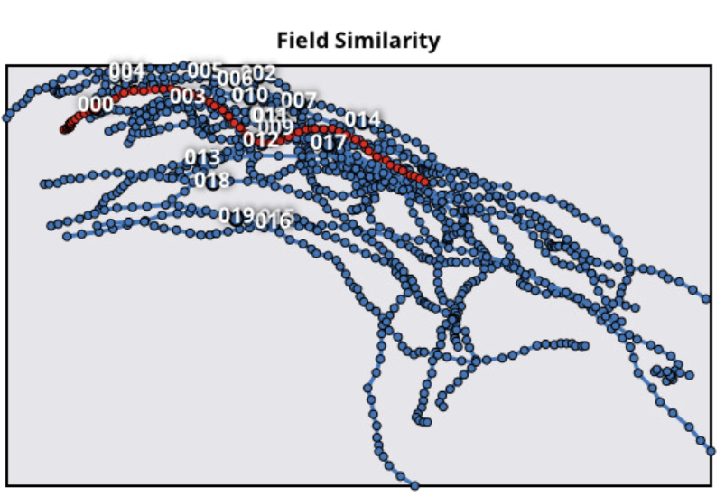
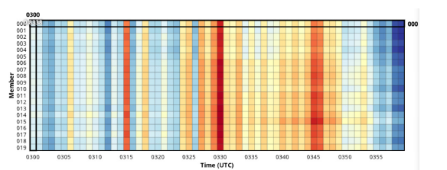
Example of analysis
Ascending air current and clouds, with strong non-linearity
Producing high variability in the simulation results
Reducing the accuracy of the simulation model
Case study
Variable: QR (mixture ratio of rainwater)
Ensemble members: 20
Timesteps: 60
Resolution: 301 x 301 x 50
Affected by the period of cumulonimbus cloud development?
3:15
3:30
3:45
Densely
Plotted
(Similar)
Time
Separately plotted
(Not similar)
Similar
Not similar
Time
Notes:
Here is an analytics case study for the variable QR (mixture ratio of rainwater).
The ensemble data used in this study is composed of 20 ensemble members with 60 timesteps, and each member has the resolution of 301x301x50.
The left figure shows the time evolutions of the ensemble members on the dimensionality reduction plot view.
And the right figure shows the similarity between each of the ensemble members in comparison to the ground truth data on the timeline heatmap plot view.
In this plot, blue color indicates that the distance of the ensemble member is close to the ground truth data, that is, the similarity is high, and red color that the distance of the ensemble members is far from the ground truth data.
(CLICK)
From these figures, we can verify that the similarity between each of members and the ground truth data is high at the beginning of the simulation, and that the similarity decrease as time evolution. This indicates the influence of data assimilation process.
The right figure also shows three red bands at regular intervals.
(CLICK)
After confirming this with domain expert, this can be explained from the fact that cumulonimbus clouds that bring heavy rainfall have a timeframe from 10 to 15 minutes, from the development to the precipitation onto the ground, so it is natural to consider this influence at every 15 minutes.
It was then suggested that this period of cumulonimbus cloud development affects the errors between the ensemble members and the ground truth data at regular intervals.
(CLICK)
Some considerations for the probabilistic isosurface plot view are also obtained, but are omitted here for time reasons.

Slide 27
Visual Analytic System
Weather ensemble data analysis
Angular-based PCP plot view
Angular distribution plot view
Cross-sectional plot view
Binning PCP
plot view
Notes:
This is another visual analytics tool based on the parallel coordinates plots to analyze the relationship between the variables.
(I will also omit the detailed explanation due to lack of time) This system is composed of four views, (CLICK) angular-based parallel coordinates plot view to select the ensemble member of interest, (CLICK) angular distribution plot view to confirm the correlation of the selected variables, (CLICK) binning parallel coordinates plot view to show the relationship between all variable of the selected ensemble member, and (CLICK) cross-sectional plot view to show the spatial distribution of the selected variable.

Slide 28
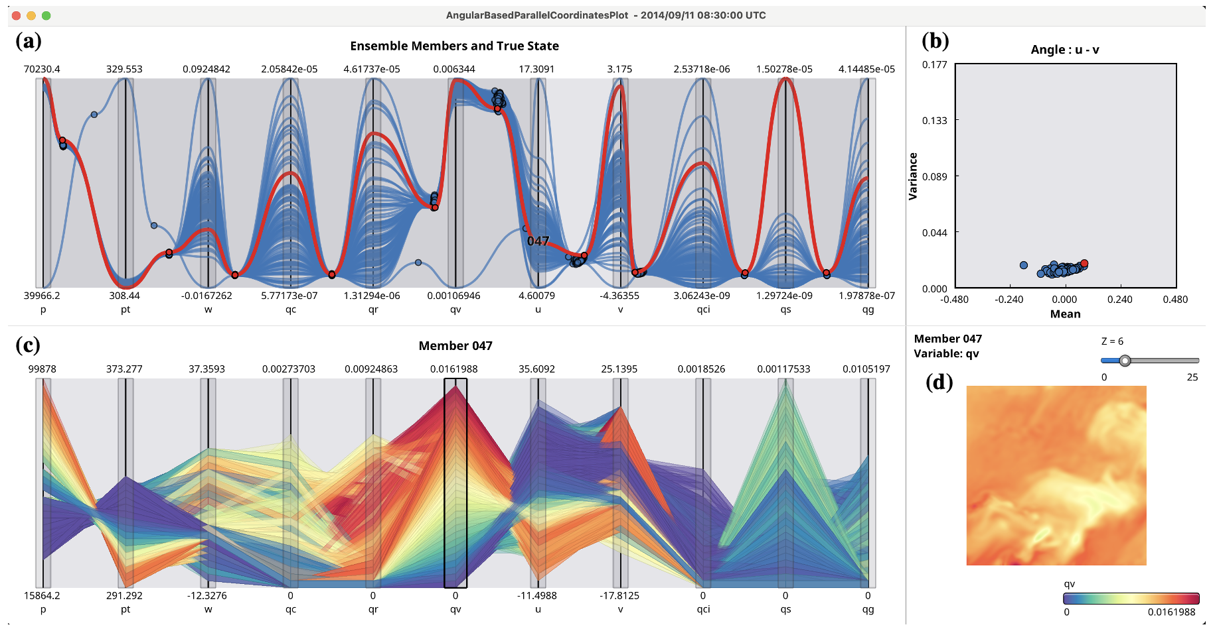
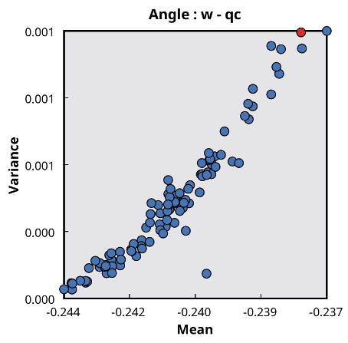
Workflow
Analysis with the fixed time point
M
Angular-based
PCP
V
Select & compare
members
Find members of
interest
M
F
Slicing
by t_{i}
Slicing
by m_{j}
T
F
…
V
V
Slicing
by selected m’
F
T
Angular Distribution Plot
Select & compare variables
…
Angular Distribution
V
Binning
Binning PCP
Observe spatial
distribution of variable
F
T
Data
Analysis
Visualization
Interaction
Notes:
This is overview of the system workflow consists of just slicing.

Slide 29
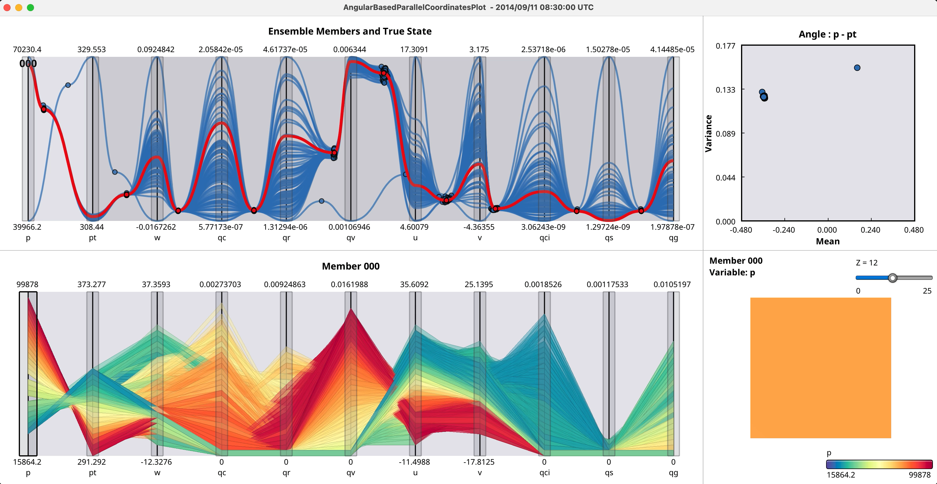

Slide 30
Conclusion
Tensor based visual analytics
Concise workflow description by using tensor models
Easy application of data analysis techniques such as dimensionality reduction
Efficient data analysis by combining effective visualization techniques
Further improvement of data interpretability is a future challenge
Notes:
In this talk, I introduced visual analytics systems based on tensor data model.
In the tensor based visual analytics,
Concise workflow can be described by using tensor data models.
Data analysis techniques such as dimensionality reduction can be easily applied.
The data can be analyzed by combining effective visualization techniques.
Further improvement of data interpretability is a future challenge.

